Slide 1
Business Contract Validation
Team Mentor:
Dr. T.V. Rajinikanth
Professor & HOD, CSE-AIML
Team TechSmashers
Prem Kiran
Vidhya
Deekshitha
S . Sri Harsha Varma
Vishal Anup Kumar

Slide 2
Problem Statement:
Business Contract Validation -To Classify Content within the Contract Clauses and Determine Deviations from Templates and highlight them.
Description : Business contracts are legal documents. The first task is to parse these documents so that have a structure to them. Determine the key details within the contract document. Every contract has clauses and sub-clauses. The next step is to classify the contents of the parsed documents to these clauses. Typically, a contract has an associated template to it, and it is important to determine the deviations from that template and highlight them.

Slide 3
Introduction
The integrity and compliance of contractual agreements are crucial in today's fast-paced business environment.
The Business Contract Validation project aims to streamline the validation and management of business contracts to ensure adherence to predefined templates and compliance standards.
This project involves parsing legal documents, extracting key details into clauses, and identifying deviations from standard templates.
Automating the validation process enhances accuracy, reduces non-compliance risks, and provides a robust framework for efficient contract management.
The innovative approach uses advanced data processing techniques to transform unstructured contract data into structured insights, ensuring transparent, consistent, and enforceable business agreements.

Slide 4
Workflow
Input Layer: The documents enter the system through the input layer.
Preprocessing: The documents undergo preprocessing to clean and prepare the data for analysis, and text processing techniques are then applied to extract and structure the information.
Feature Extraction: Relevant features are extracted from the processed text.
Gemini Model: The extracted features are passed through the Gemini Model for further analysis.
Comparison Engine: The model compares the features to predefined templates and standards.
Highlighting Deviations: Any deviations from the templates are highlighted.
Output Layer: The system generates reports on the identified deviations.
Report Generation: Reports are generated to present the findings.
Interface: Users can access the system through a web interface, interact with the system using the user interface, and integrate with other systems or applications through an API interface.

Slide 5
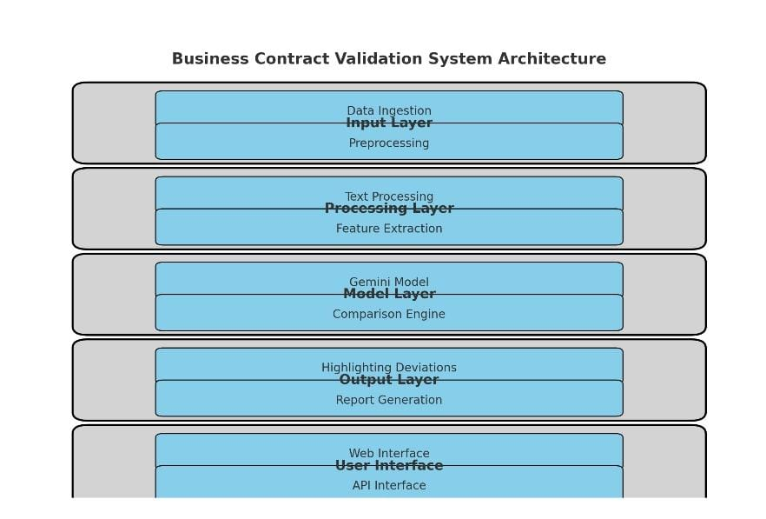
ARCHITECTURE

Slide 6
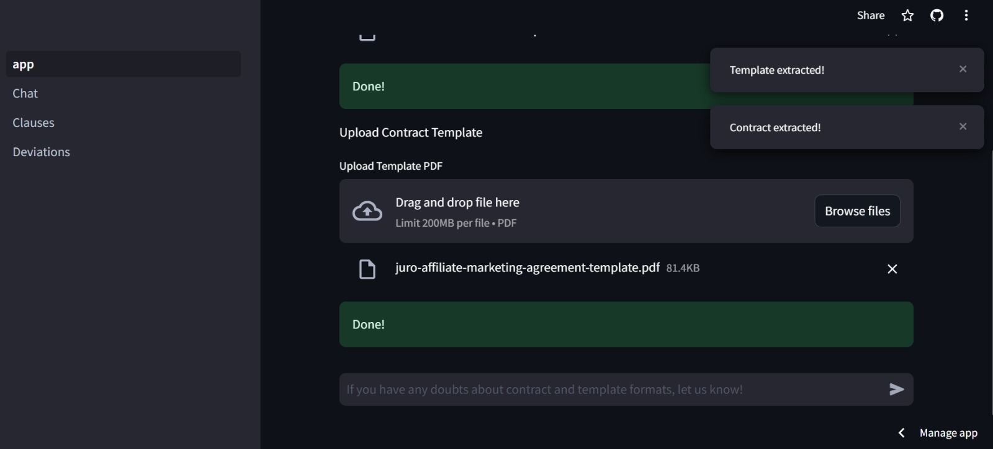
RESULTS

Slide 7
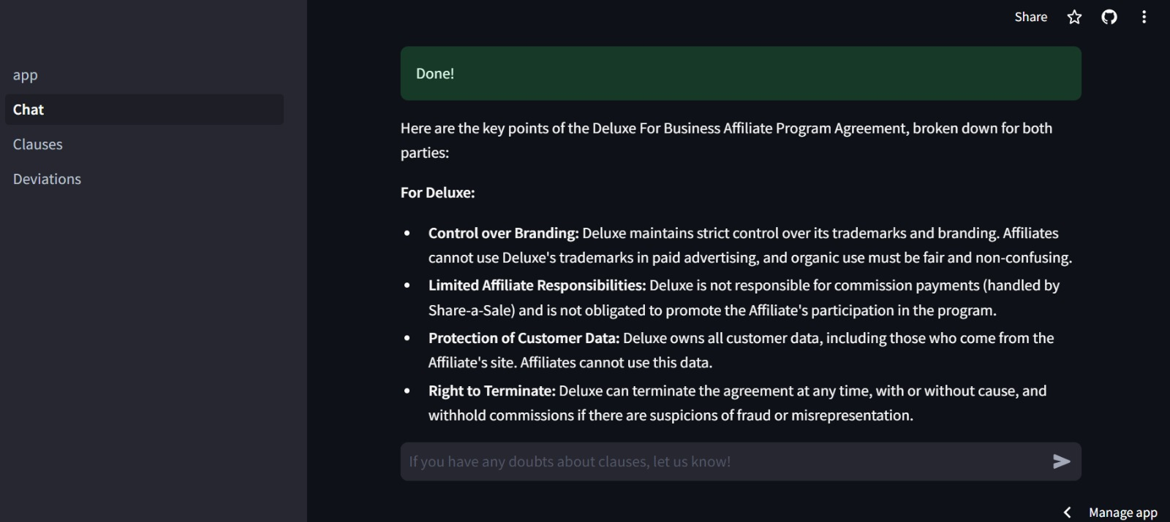

Slide 8
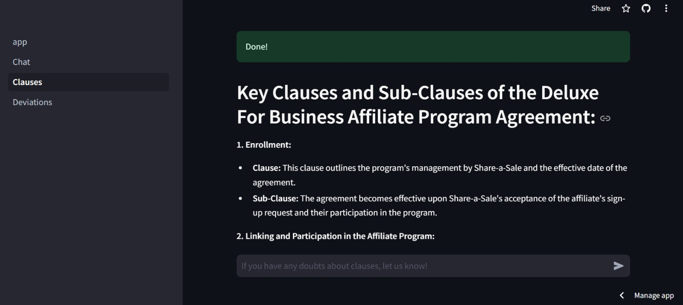

Slide 9
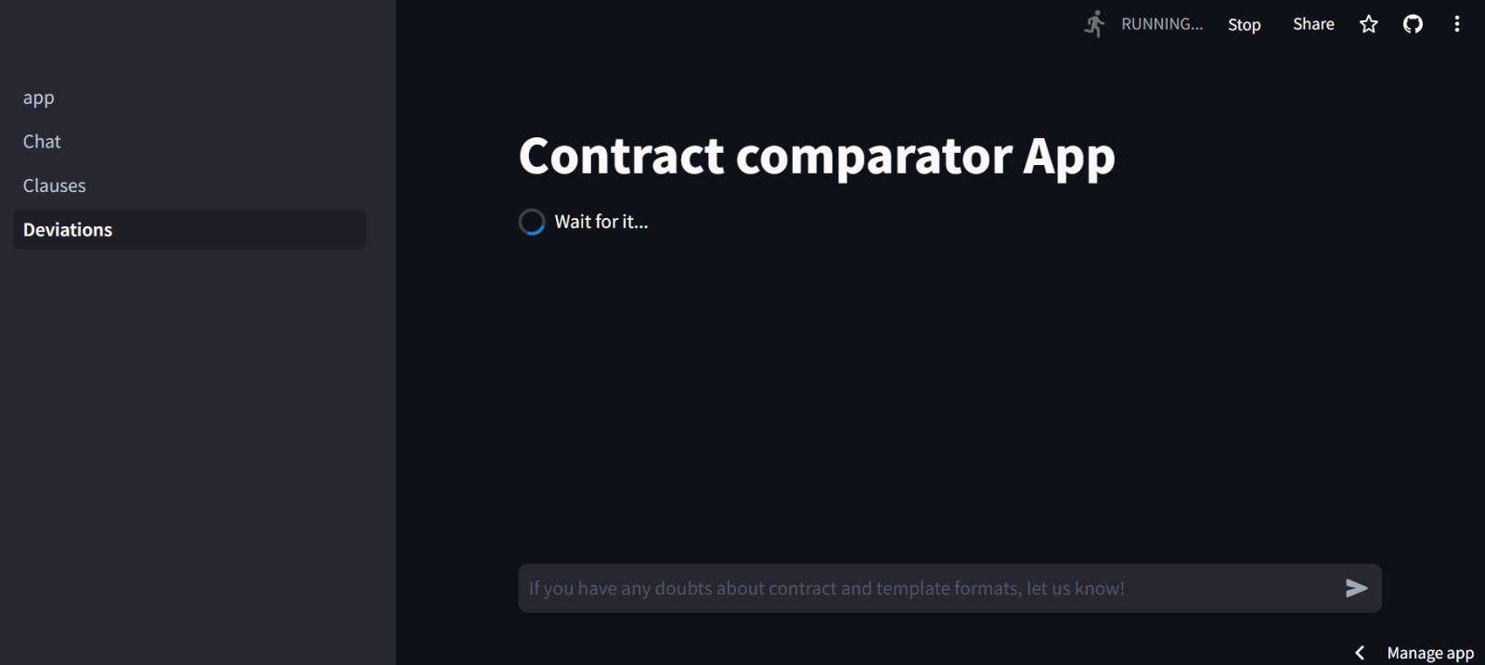

Slide 10
CONCLUSION
Business contract validation ensures clarity, compliance, and risk management.
Categorizing clauses and addressing deviations promptly enhances contract effectiveness, mitigates legal risks, and maintains transparent business relationships.
This systematic approach supports operational efficiency and strengthens contractual foundations, crucial for sustainable business practices and regulatory compliance.

